Slide 1
Web Engineering
Lecture 5
Web Based Applications Architecture
Zulfiqar Ahmad
Lecturer
Department of Information Technology
Hazara University Mansehra
zulfiqarahmad@hu.edu.pk

Slide 2
Information System
A collection of components that work together to process data into accurate information using the information processing cycle
Information processing cycle – involves:
Input
Processing
Output
Storage

Slide 3
Information System Components
The main components of an information system are:
Data – collected data and facts used as inputs for system processing
Procedures – manual procedures, guidelines, business rules, and policies implemented in the system
Hardware – computer systems and devices
Software – applications, operating systems, and any other utilities used
Network – communication infrastructure to connect client processes to the system
People – users, managers, database administrators, programmers, systems analysts, systems administrators

Slide 4
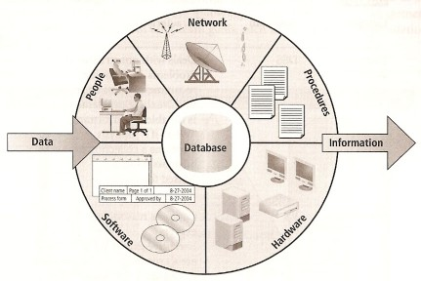
Information System Components…

Slide 5
Information System Usage
A collection of components that work together to process data into accurate information
Can be categorized based on usage
Lower-level management – uses information system to assist management and employees with operational tasks like inventory systems
Middle-level management – uses information systems that deal with midterm goals like forecasting
Upper-level management – works with information systems that assist with long-term decision-making goals

Slide 6
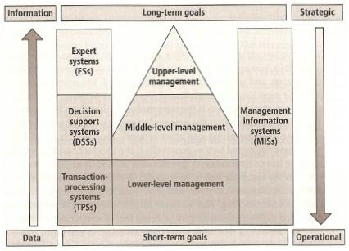
Information System Usage…

Slide 7
Information System Usage Categories
Information systems are classified mainly into the following distinct categories based on their usage:
Transaction-processing systems (TPS) – used for operational tasks like order tracking, customer service, payroll, etc
Decision-support systems (DSS) – used for tactical management tasks like sales forecasting, risk management, etc
Expert systems (ES) – captures reasoning of human experts like loan experts, market analysts, etc

Slide 8
Architecture
High-level plan or strategy for building applications
Can have a number of tiers (usually up to 5 tiers)
The tiers may place data management, application logic, and the user interface into separate processes or combine them in some manner

Slide 9
One-Tier Architecture
Combines data management, application logic, and the user interface into a single executable file
Many old data processing applications like COBOL programs use this architecture
Current desktop (PC) applications like MS Access applications also use this architecture

Slide 10
Two-Tier Architecture
Organizes an application into two layers
User interface layer
Data management services layer
The application/business logic may be in either or both layers
Often used in conjunction with client-server computing which has:
Clients – sends requests to the server
Server – manages requests from clients

Slide 11
Three-Tier Architecture
Cleanly separates data management, application logic, and the user interface into different layers
User interface – manages forms and reports
Data management – holds the database structure
Application layer – holds the application logic

Slide 12
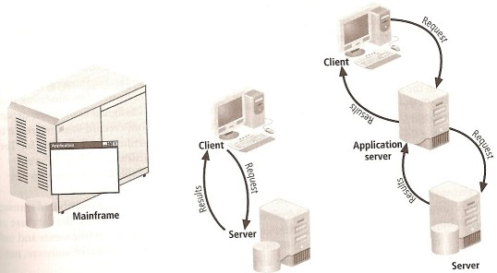
Tiered Architectures

